Slide 1

AUTOMATIC PIANO FINGERING DETECTION FROM VIDEO
Anastasia Deniz Durak - 2238351
Emine Esin Yılmaz - 2252231
Computer Vision Final Project
Master's Degree in Computer Science
Academic Year 2025/2026
Notes:
1.7.2013
1
‹#›

Slide 2
Outline
1. Introduction & Goal
2. Related Work & Our Contributions
3. Dataset: PianoVAM
4. Pipeline Overview
5. Stage 1: Automatic Keyboard Detection
6. Stage 2: Hand Pose Estimation
7. Stage 3: Temporal Filtering
8. Stage 4: Finger-Key Assignment (Gaussian)
9. Stage 5: Refinement (Viterbi & BiLSTM)
10. Evaluation & Results
11. Ground Truth Evaluation (Visual Reference)
12. Error Analysis
13. Limitations & Future Work
14. Conclusion & References

Slide 3
Introduction
The Problem
Our Goal
Given a video of a piano performance and synchronized MIDI, automatically determine the finger assignment (1-5, thumb to pinky) for each played note using computer vision.
Learning piano requires knowing which finger to use for each note
Most sheet music lacks fingering annotations
Learners watch online video performances to learn
Manual annotation is tedious and subjective
Incorrect fingering leads to awkward hand positions, slower playing, and injury risk
Input: Video + MIDI → Output: Per-note finger labels (L1-L5, R1-R5)
Fully automatic — no manual annotations used in the detection pipeline

Slide 4
Reference Paper & Our Contributions
Moryossef et al. (2023) — "At Your Fingertips"
Video-based pipeline: Video → Keyboard → Hands → Assignment. Key idea: use x-distance only in a Gaussian probability model, avoiding y-bias from different finger lengths.
Fully automatic keyboard detection
Advanced temporal filtering
Constrained Viterbi decoding
Canny + Hough + clustering + black-key contour analysis. CLAHE, Otsu, morphological ops, multi-frame consensus. IoU = 0.946.
3-stage: Hampel outlier rejection + linear interpolation + Savitzky-Golay smoothing. Doubles note coverage (3,337 → 6,915).
Biomechanical constraints on Gaussian emissions. Reduces IFR by 40%. No neural network required.
BiLSTM + Attention (experimental)
Visual Reference Ground Truth
Different dataset: PianoVAM
Sequence model with self-attention. Key finding: adds NO benefit over Viterbi-only; damages finger accuracy.
Independent evaluation using dataset skeletons + 2D Euclidean distance. Enables finger-level accuracy measurement (~70%).
107 performances with video, audio, MIDI. Not used in original paper. Comprehensive evaluation framework with baselines.

Slide 5
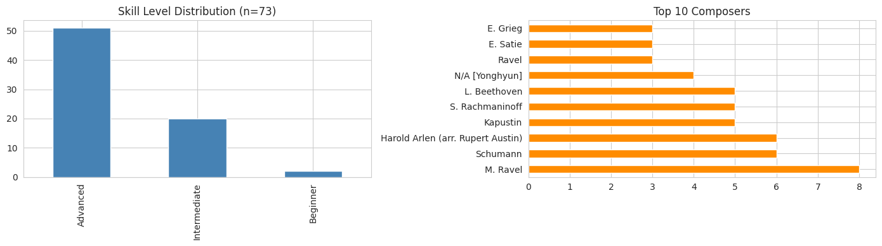
Dataset: PianoVAM (KAIST, 2025)
Property | Value
Total recordings | 107 piano performances
Data modalities | Synchronized video, audio, MIDI
Hand skeletons | Pre-extracted 21-keypoint (MediaPipe)
Camera setup | Top-down, 1920x1080, 60 fps
Skill levels | Beginner / Intermediate / Advanced
KB annotations | 4-point corner coords (eval only)
How We Used the Data
Video frames → Keyboard detection (automatic)
MIDI / TSV → Note onset times, pitch info
Pre-extracted skeletons → Validation only
Corner annotations → ONLY for IoU eval
We used total 600 seconds of video for train+ test
Resulting in ~3,700 notes total

Slide 6
Our Pipeline for Automated Fingering Detection
Full-CV approach: Keyboard detected automatically from raw video — no dataset annotations used in pipeline
1
2
3
4
5
Keyboard
Detection
Hand Pose
Estimation
Temporal
Filtering
Finger-Key
Assignment
Refinement
→
→
→
→
Canny + Hough
Clustering
Black-key refine
MediaPipe
21 keypoints
Per hand
Hampel + Interp
Savitzky-Golay
3-stage clean
Gaussian x-only
Both hands eval
Max-dist gate
Viterbi decoding
Biomechanical
constraints
Video + MIDI → Keyboard BBox → Hand Skeletons → Finger Assignments → Refined Sequence

Slide 7
Recap of Some Evaluation Metrics Before We Start
IFR = Irrational Fingering Rate
IoU = Intersection over Union
Fraction of note transitions that violate biomechanical constraints. Lower = better. No GT labels needed.
Irrational transitions include: same finger on notes >2 semitones apart, finger stretch beyond physical limits, invalid finger crossings.
Measures keyboard detection quality by comparing auto-detected bounding box against ground-truth corner annotations.
Corner annotations used ONLY for this evaluation metric — never in the detection pipeline.

Slide 8
Stage 1: Keyboard Detection — Automatic CV Pipeline
1
Preprocessing: Grayscale + CLAHE contrast + Gaussian blur
Key Results
2
Edge detection: Dual-threshold Canny (fixed + Otsu-adaptive), merged via OR
0.946
3
Morphological closing: 15x1 horizontal kernel connects fragments
Single-frame IoU (demo sample)
4
Line detection: Probabilistic Hough Transform → H + V lines
0.897
5
Clustering: Horizontal lines clustered by y-coord; pairs scored for edges
Mean IoU (5 test samples)
6
Black-key refinement: Contour analysis to tighten x-boundaries
88 keys: 52 white + 36 black
7
Multi-frame consensus: Sample 7 frames, take median bbox
No manual annotations used

Slide 9
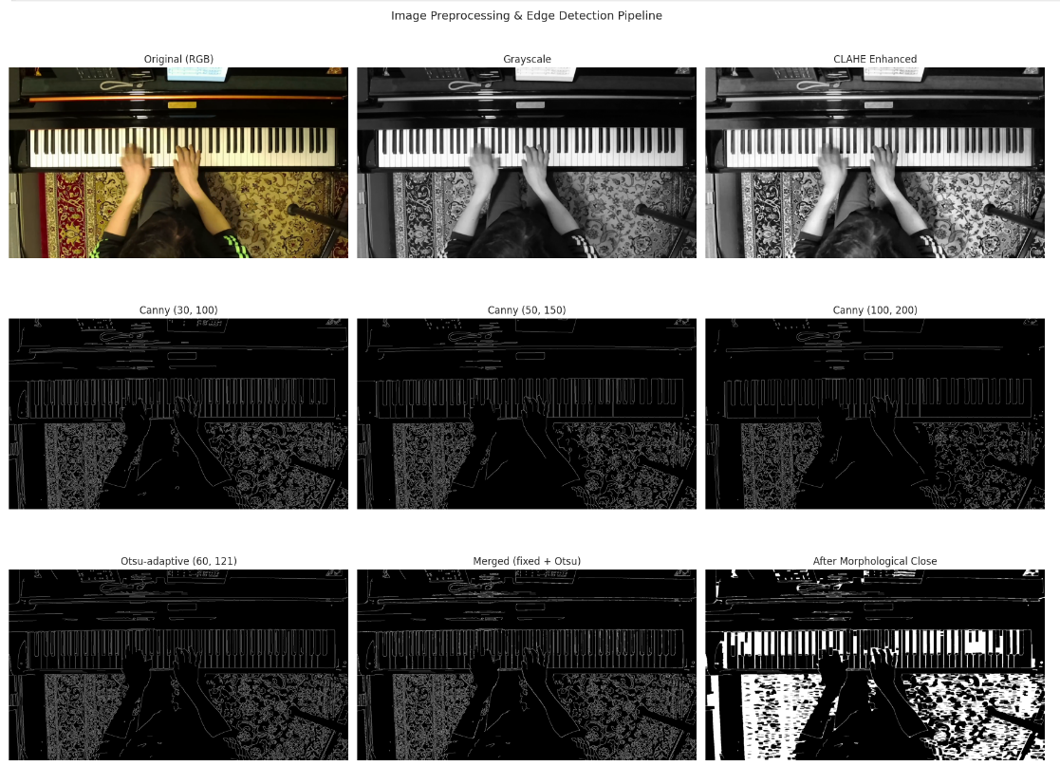
Keyboard Detection — Image Preprocessing & Edge Detection

Slide 10
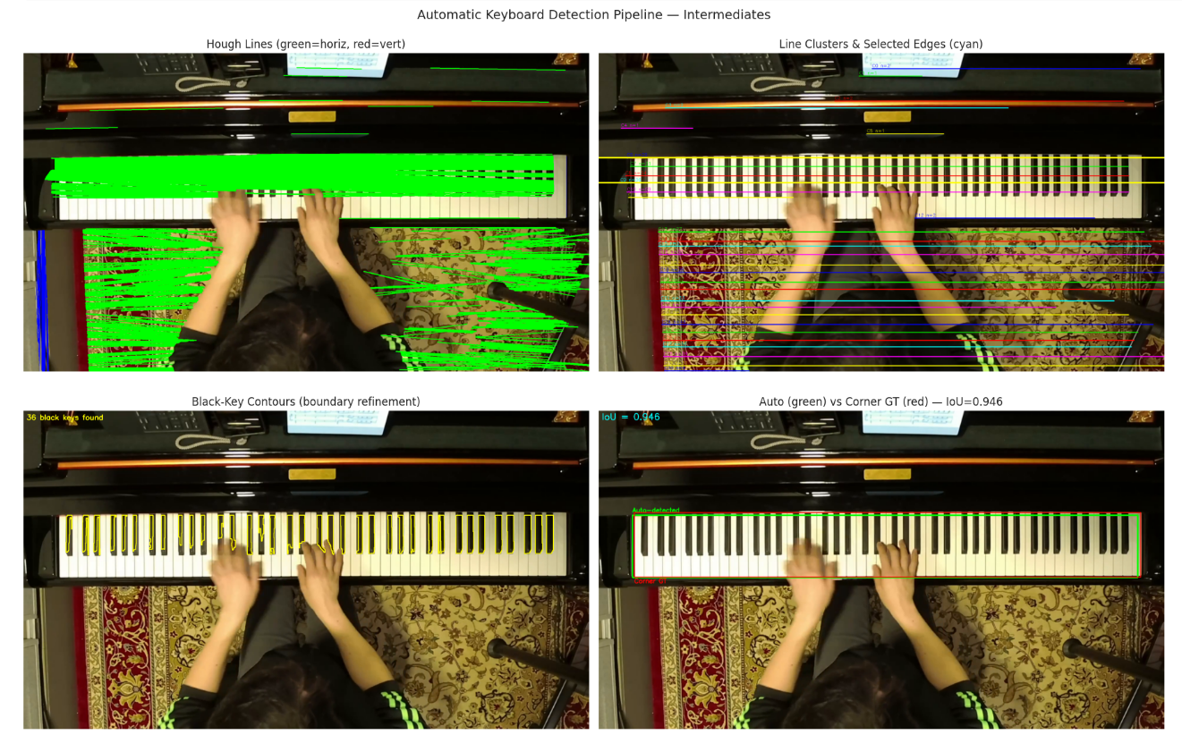
Keyboard Detection — Hough Lines, Clustering & IoU

Slide 11
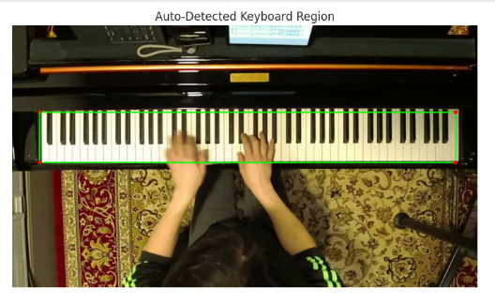
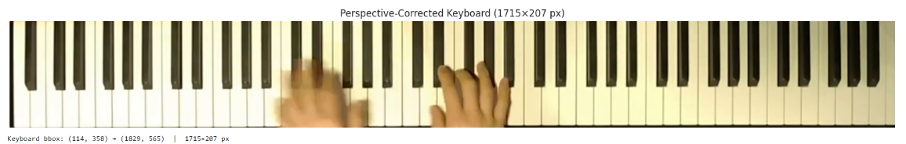
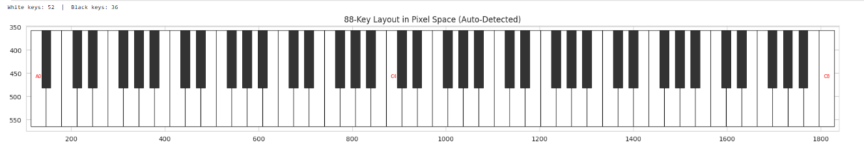
Keyboard Detection — Homography & 88-Key Layout

Slide 12
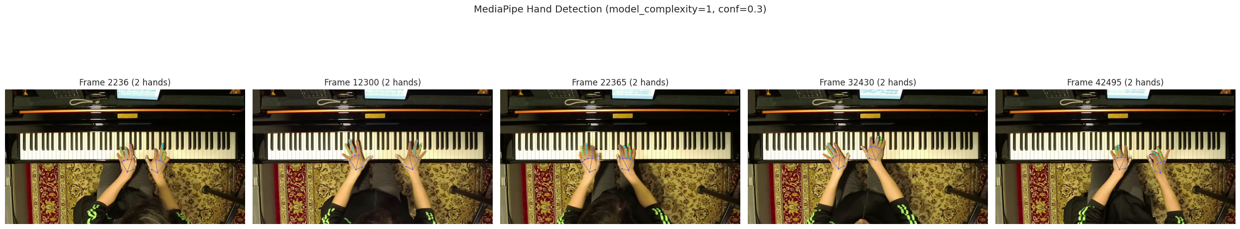
Stage 2: Hand Pose Estimation (Live MediaPipe)
MediaPipe Configuration
Validation vs Dataset Skeletons-covered more in detail on Skeleton vs Mediapipe Comparison Slide
We run MediaPipe Hands directly on the raw video to detect 21 hand landmarks per hand — no pre-extracted skeleton data from the dataset is used.
Metric | Right | Left
PCK@0.02 | 97.8% | 98.3%
Trajectory r | 0.995 | 0.988
Key agree | 87.0% | 88.2%
model_complexity=1 (full model, higher accuracy)
min_detection_confidence=0.3 (catches fast/occluded hands)
static_image_mode=False (video mode, temporal tracking)
21 keypoints per hand (5 fingertips: indices 4, 8, 12, 16, 20)

Slide 13
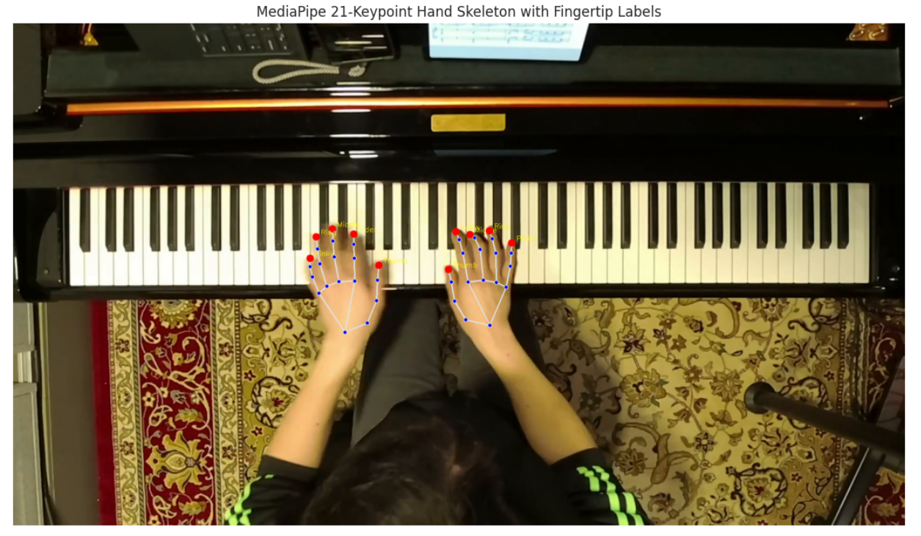
Stage 2: Hand Pose Estimation (Live MediaPipe)

Slide 14
Stage 3: Temporal Filtering of Landmarks
Key Impact
MediaPipe landmarks are noisy. We apply a 3-stage filtering pipeline:
3,337 → 6,915
assignable notes (doubled!)
IFR: 0.475 → 0.446
6.3% improvement
(this data is existent on the ablation study)
1. Hampel Filter
2. Linear Interpolation
3. Savitzky-Golay
Window=20, threshold=3σ
Removes outlier spikes via MAD
Replaces with local median
Fills gaps up to 30 frames
Longer gaps left as NaN
Prevents hallucinated positions
Window=11, polynomial=3
Smooths while preserving edges
Better than moving average

Slide 15
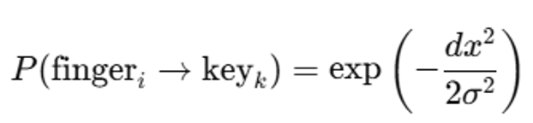
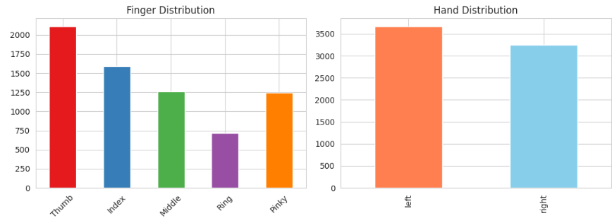
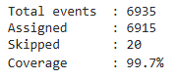
Stage 4: Finger-Key Assignment (Gaussian Model)
X-Only Gaussian Probability Model
Gaussian probability model in image-pixel space (not homography-warped space). Uses x-distance only to avoid y-bias from different finger lengths. Tries both hands for each key, picks the higher-confidence assignment. Max-distance gate rejects assignments when the hand is too far from the key
σ auto-scales to mean white-key width (~33px)
Why x-only? Y-axis = depth into keyboard. Varies with finger length (thumb < middle). Using y creates systematic bias.
Max-distance gate: reject if closest tip > 4σ
Both hands evaluated independently, higher confidence wins
99.7%
Coverage (6,915 / 6,935)

Slide 16
Stage 5: Refinement — Viterbi & BiLSTM
Constrained Viterbi (Recommended)
BiLSTM + Viterbi (Experimental)
Dynamic programming on Gaussian emission probabilities with biomechanical constraints:
Max stretch limits per finger pair
Same-finger repetition penalty (>2 semitones)
Finger ordering in ascending/descending passages
Thumb-under / finger-over crossing rules
No neural network or training data required
IFR reduced by 40% vs Gaussian baseline
Architecture:
Input(20) → Linear(128) → BiLSTM(128x2) → Self-Attention(4 heads) → Linear(5)
958,853 parameters. Self-supervised: Gaussian outputs as labels.
Input features (20 dims): normalized pitch, one-hot finger, time delta, hand encoding, pitch class
KEY FINDING:
BiLSTM+Viterbi = identical IFR to Viterbi-only.
BiLSTM damages finger accuracy: 69.6% → 44.8%
BiLSTM alone (no Viterbi): IFR = 0.693 — worse than random (0.518)!

Slide 17
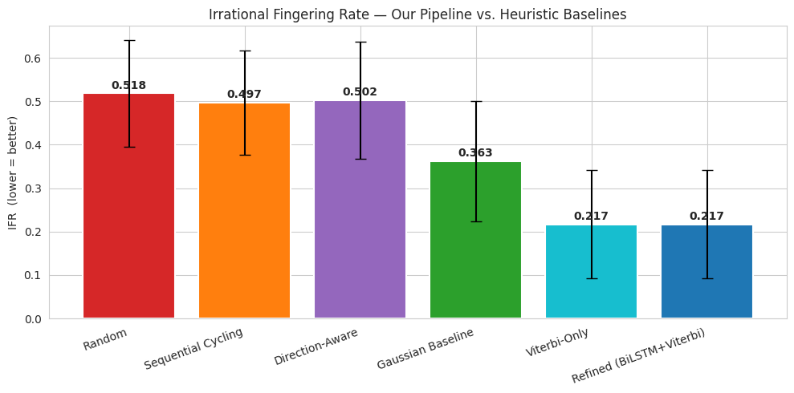
Evaluation: Baseline Comparisons (IFR)
Method | Mean IFR | vs Random
Random | 0.518 | —
Sequential Cycling | 0.497 | -4.1%
Direction-Aware | 0.502 | -3.1%
Gaussian Baseline | 0.363 | -30.0%
Viterbi-Only | 0.217 | -58.1%
BiLSTM+Viterbi | 0.217 | -58.1%
Viterbi-only = BiLSTM+Viterbi
→ BiLSTM adds zero improvement

Slide 18
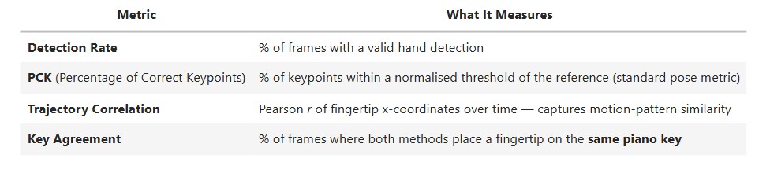
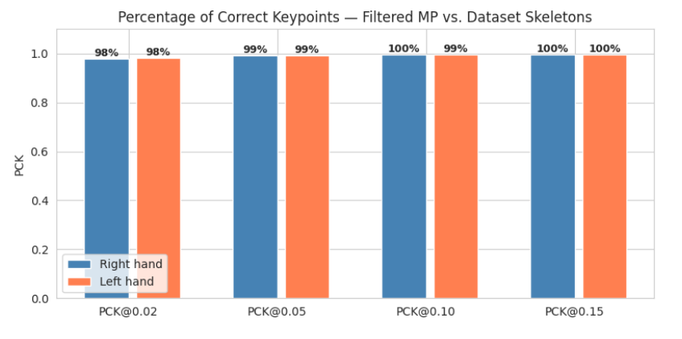
Hand Detection Validation — Post-Filtered MediaPipe vs. Dataset Skeletons
PianoVAM provides pre-extracted hand skeletons for every video. Our pipeline uses live MediaPipe detection followed by temporal filtering (Hampel → interpolation → Savitzky-Golay).
Here we validate our post-filtered detections against the dataset's reference skeletons using standard pose-estimation metrics.
This validates the output that actually feeds into finger-key assignment — not the noisy raw MediaPipe output.
PCK is the standard evaluation metric in pose estimation (Andriluka et al., 2014). Small spatial offsets still count as correct if they fall within the threshold.
Note: Differences are expected — the dataset skeletons were extracted with a different MediaPipe version, different detection parameters, and potentially different hand labelling conventions. Our temporal filtering additionally smooths trajectories. What matters is that both methods capture the same underlying hand motion.

Slide 19
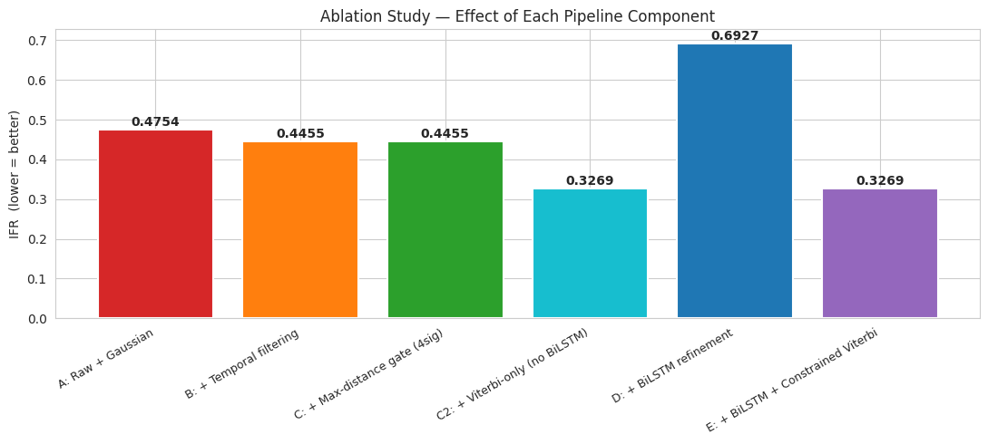
Ablation Study
We evaluate the contribution of each pipeline component by progressively enabling stages and measuring the effect on IFR. This is run on the demo sample whose landmarks are already cached.
Config | IFR | Notes
A: Raw + Gaussian | 0.4754 | 3,337 notes
B: + Temporal filter | 0.4455 | +107% coverage!
C: + Max-dist gate | 0.4455 | 6,915 notes
C2: Viterbi-only | 0.3269 | Best config!
D: BiLSTM only | 0.6927 | Worse than random!
E: BiLSTM+Viterbi | 0.3269 | = Viterbi-only
1. Temporal filtering doubles coverage (3,337→6,915) and reduces IFR by 6.3% 2. Viterbi performs ALL useful constraint enforcement 3. BiLSTM alone = 0.693 IFR (worse than random 0.518)

Slide 20
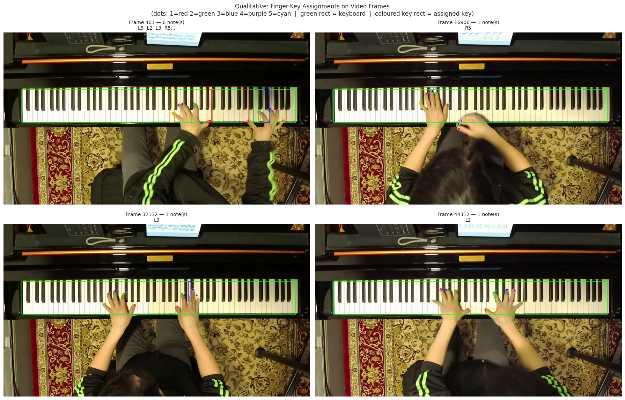
Qualitative Analysis — Finger Assignments on Video

Slide 21
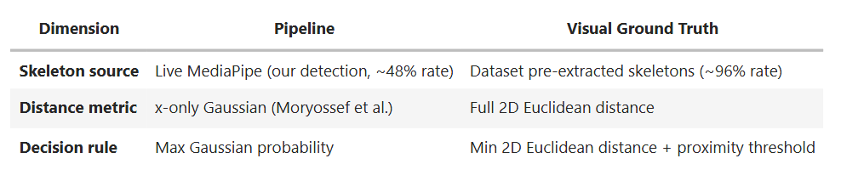
Ground Truth Evaluation — Visual Proximity Analysis
A critical limitation acknowledged throughout this project is the absence of per-note finger labels in the PianoVAM dataset. All evaluations so far (IFR, baseline comparisons, ablation) measure internal consistency and physical plausibility, they never tell us whether a predicted finger is actually correct.
To address this, we construct a Visual Reference Ground Truth using an approach that is doubly independent from our pipeline:
Methodology
For each MIDI note onset:
Retrieve the dataset's pre-extracted skeleton at the onset frame (independent from our live detection).
Compute the 2D Euclidean distance from every fingertip (both hands) to the pressed key's centre.
Select the closest fingertip as the ground-truth finger.
Reject assignments where the closest fingertip exceeds a strict proximity threshold (2× mean key width) — these are frames where no finger is confidently pressing the key.
This procedure mirrors what a human annotator would do: look at the video frame, see which finger is physically on the key, and label it. The strict threshold ensures we only evaluate notes with high-confidence visual evidence.

Slide 22
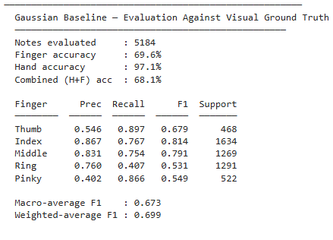
Ground Truth Evaluation — Visual Proximity Analysis
Metrics Computed
Accuracy : Exact match rate between pipeline and visual GT
Per-finger Precision / Recall / F1 : Identifies systematic finger-level errors
Confusion matrix : Reveals substitution patterns (e.g., Index↔Middle confusion)
Baseline vs Refined : Compares Gaussian baseline and BiLSTM+Viterbi against the same GT
Multi-threshold analysis : Sensitivity of accuracy to the GT proximity threshold
Note: This visual ground truth is a surrogate, it is not human expert annotation. However, because it uses a completely different skeleton source and distance metric, disagreements between it and our pipeline represent genuine differences in how fingers are identified, not just measurement noise.

Slide 23
Finger Accuracy — Visual Reference GT Results
69.6%
97.1%
0.673
93.2%
Finger Accuracy
Hand Accuracy
Macro F1
High-Confidence
Gaussian Baseline
Left/Right correct
Across 5 fingers
0.5x key width
Method | Finger Acc | Hand Acc | Combined | Macro F1
Gaussian Baseline | 69.6% | 97.1% | 68.1% | 0.673
Viterbi-Only | 60.2% | 97.1% | 58.9% | 0.584
BiLSTM+Viterbi | 44.8% | 97.6% | 43.4% | 0.390
Cross-sample test (5 samples): Baseline finger accuracy = 67.1% ± 6.2% | Hand accuracy = 98.2% ± 1.7%

Slide 24
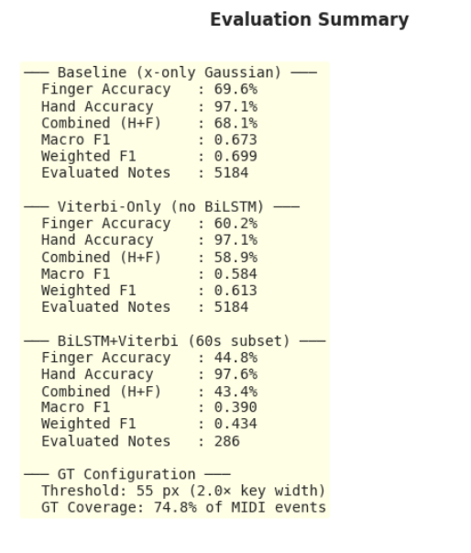
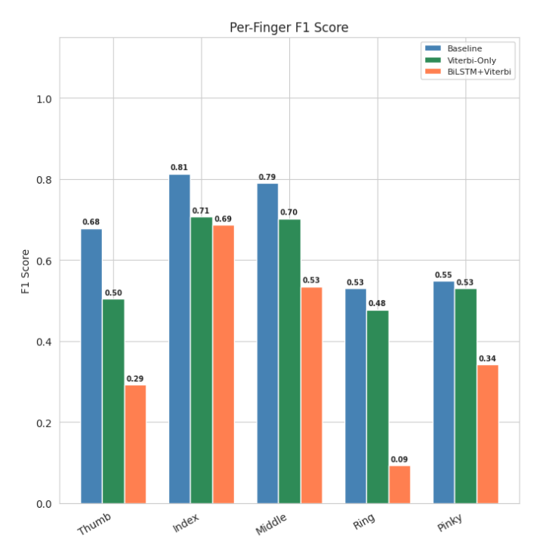
Ground Truth Evaluation

Slide 25
Understanding the Trade-Off
Gaussian Baseline
Viterbi-Only
Per-note: looks at each note independently
Like a spellchecker that gets 70% of words right but produces grammatically broken sentences.
Accuracy: 69.6%
IFR: 0.363 (36% impossible)
Sequential: enforces valid transitions
Like a grammar checker that fixes sentence structure but sometimes picks a less precise synonym.
Accuracy: 60.2%
IFR: 0.217 (40% fewer violations)
Why Include Viterbi If Baseline Has Higher Accuracy?
Accuracy and IFR measure different things.
The Gaussian baseline identifies the correct finger 69.6% of the time, but produces biomechanically impossible transitions 36.3% of the time.
Viterbi enforces physical constraints — no human hand can play some of these transitions. A musically valid fingering that's occasionally wrong is more useful than a per-note accurate one full of impossible jumps.
Both methods have value. The Gaussian baseline is a better per-note predictor. Viterbi produces more playable sequences. This is why our pipeline offers both — the user's application determines which matters more.

Slide 26
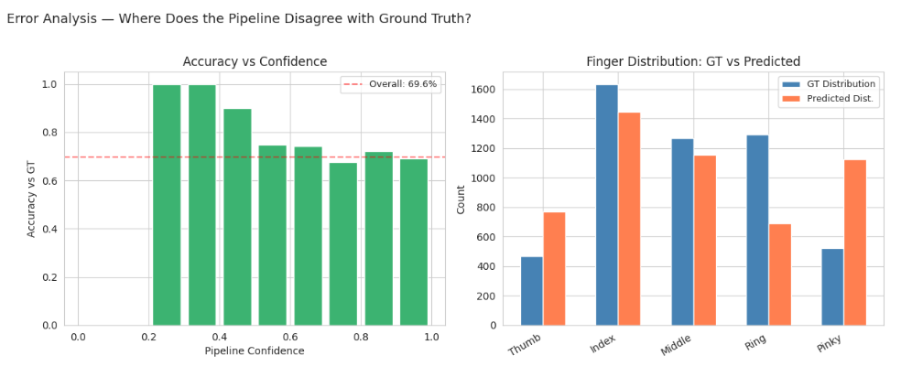
Error Analysis — Per-Finger Performance
Finger | Precision | Recall | F1 | Support
Thumb | 0.546 | 0.897 | 0.679 | 468
Index | 0.867 | 0.767 | 0.814 | 1,634
Middle | 0.831 | 0.754 | 0.791 | 1,269
Ring | 0.760 | 0.407 | 0.531 | 1,291
Pinky | 0.402 | 0.866 | 0.549 | 522
Top Substitution Errors (1,576 total)
Ring → Pinky
39.6% (624)
Index → Thumb
20.3% (320)
Middle → Index
8.9% (141)
Index and Middle are best recognised (F1 > 0.79) :
strongest positional signal on the keyboard.
Ring and Pinky commonly confused (39.6% of errors) :
anatomically close, x-coordinates overlap in Gaussian model.
Thumb has high recall (0.897) but low precision (0.546):
pipeline detects thumbs well but falsely assigns others as thumb.
Mid-low register (C3-B4): 75.0% — best
Low register (A0-B2): 45.3% — compressed hands cause confusion

Slide 27
Limitations & Future Work
Current Limitations
Future Work
Surrogate Ground Truth
Human Expert Annotations
2D-closest fingertip assumption may fail in fast polyphonic passages
Definitive GT for supervised evaluation
Adjacent-Finger Confusion
Selective Y-Distance
Ring-Pinky (39.6%) and Index-Thumb (20.3%) — inherent to x-only model
Finger-length priors to disambiguate adjacent fingers
Self-Supervised BiLSTM
Supervised Neural Refinement
Training on own outputs provides no learning signal — degrades accuracy
Train BiLSTM on labeled data for genuine improvement
Offline Processing
Real-Time Pipeline
Not optimized for real-time feedback
Optimize for interactive music education
Camera Generalization
Diverse Camera Setups
Only tested on PianoVAM top-down setup (IoU drops to 0.72 worst case)
Varied angles, lighting, piano types

Slide 28
Conclusion
1
Built a fully automatic 5-stage pipeline — no manual annotations used in detection
2
Keyboard detection achieves IoU = 0.946 (demo) / 0.897 mean using classical CV (Canny + Hough + clustering)
3
Hand pose validated at PCK@0.02 = 97.8-98.3% and trajectory correlation r = 0.988-0.995
4
Gaussian x-only model achieves ~70% finger accuracy against independent visual reference GT
5
Viterbi reduces IFR by 40%, BiLSTM adds zero benefit and damages accuracy
6
Visual Reference GT enables first per-finger accuracy measurement without human annotation

Slide 29
References
[1] Moryossef et al. (2023), "At Your Fingertips: Extracting Piano Fingering from Videos", arXiv:2303.03745
[2] Kim et al. (2025), "PianoVAM: Multimodal Piano Performance Dataset", ISMIR 2025
[3] Ramoneda et al. (2022), "Auto Piano Fingering from Partially Annotated Scores", ACM MM
[4] Lee et al. (2019), "Observing Pianist Accuracy with Computer Vision", WACV
[5] Zuiderveld (1994), "CLAHE", Graphics Gems IV
[6] Otsu (1979), "Threshold Selection from Gray-Level Histograms", IEEE TSMC
[7] Zhang et al. (2020), "MediaPipe Hands: On-device Real-time Hand Tracking"
[8] Gan et al. (2024), "PianoMotion10M: Hand Motion Generation in Piano Performance"
[9] Hochreiter & Schmidhuber (1997), "Long Short-Term Memory", Neural Computation

Slide 30
Thank You!
Computer Vision Final Project — Sapienza University of Rome — 2025/2026

